Slide 1
Ch. 13 exercises

Slide 2
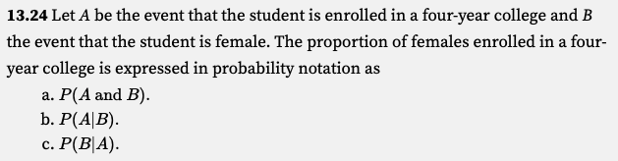

Slide 3
Correct is c.

Slide 4
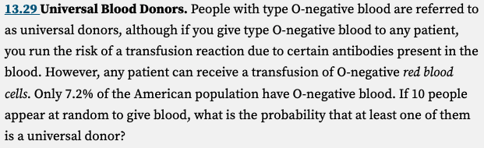

Slide 5
By rule #4 of probability
P (at least one is O-negative) = 1 − P ( none are O-negative)
P ( none are O-negative) = (1 − 0.072)¹⁰ = 0.4737
→ P (at least one is O-negative) = 1 − P ( none are O-negative) = 1 - 0.4737 = 0.5263
By multiplication rule under independence

Slide 6
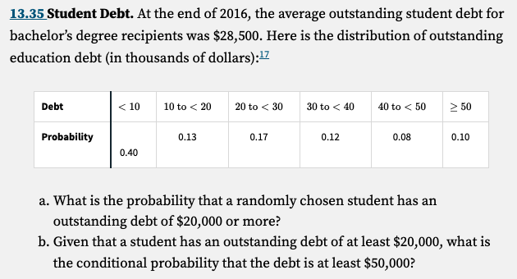

Slide 7
(a) 𝑃( $ 20,000 or more) = 0.17 + 0.12 + 0.08 + 0.10 =0.47

Slide 8
That’s the intersection of the two events
P(>= 50 and >=20) = P( >=50 )

Slide 9
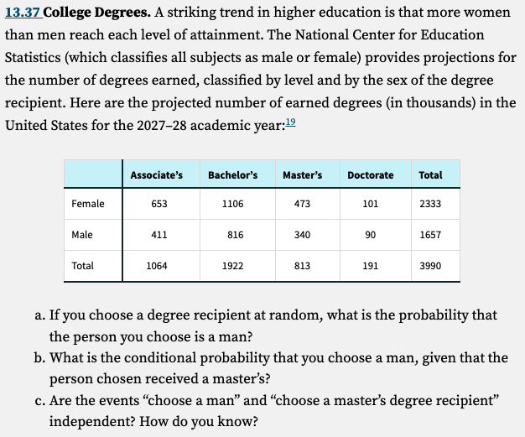

Slide 10
Let M be the event “ the person is a man” and S be the event “the person earned a Master’s degree.”
(a) P (M) = 1657/ 3990 = 0.4153 (the same as marginal proportion for men that we learned in Ch. 6)

Slide 11
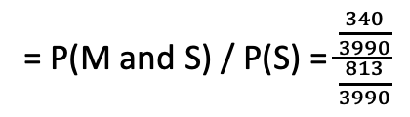

Let M be the event “ the person is a man” and S be the event “the person earned a Master’s degree.”
P (M) = 1657/ 3990 = 0.4153 (the same as marginal proportion for men that we learned in Ch. 6)
(b) P(M | S ) = 340/813 = 0.4182.
= P(M and S) / P(S) = $\frac{\frac{340}{3990}}{\frac{813}{3990}}$
= $\frac{340}{813}$

Slide 12
Let M be the event “ the person is a man” and S be the event “the person earned a Master’s degree.”
P (M) = 1657/ 3990 = 0.4153 (the same as marginal proportion for men that we learned in Ch. 6)
(b) P(M | S ) = 340/813 = 0.4182.
= P(M and S) / P(S) = $\frac{\frac{340}{3990}}{\frac{813}{3990}}$
= $\frac{340}{813}$
(c) The events “ choose a man” and “choose a Master’s degree recipient” are not independent. If they were, the two probabilities in part (a) and part (b) would be equal.

Slide 13
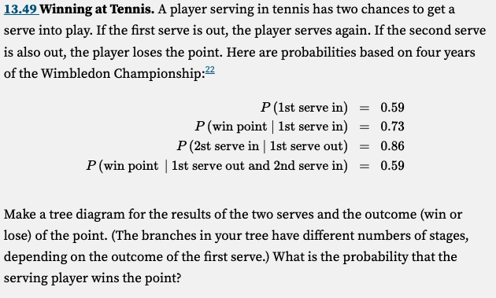

Slide 14
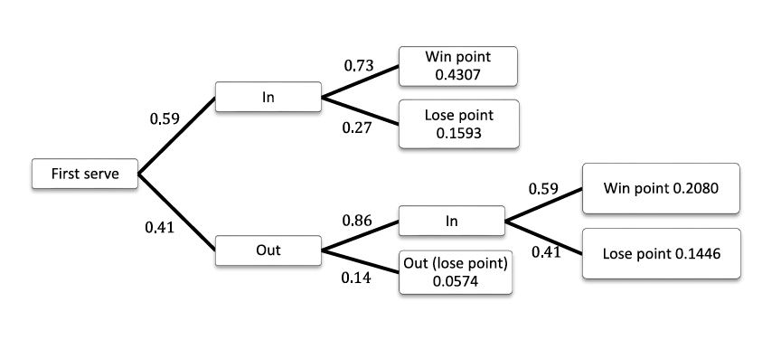
P(1st serve in and win point)
= 0.59 x 0.73 = 0.4307
the probability of each outcome is the product of the individual branch probabilities leading to it
P(1st serve out AND 2nd serve in AND win point)
= 0.41 x 0.86 x 0.59 = 0.2080

Slide 15
P(1st serve in and win point)
= 0.59 x 0.73 = 0.4307
the probability of each outcome is the product of the individual branch probabilities leading to it
P(1st serve out AND 2nd serve in AND win point)
= 0.41 x 0.86 x 0.59 = 0.2080
→ Probability that the serving players wins the point is 0.4307 + 0.2080 = 0.6387

